Slide 1
Strategic Planning 2023-28
Update to the Board of Trustees
Jeremy Smotherman, Ed.D. Senior Director,
Institutional Effectiveness, Research, & Planning
Karolina Nazario, Director,
Strategic Initiatives
Board of Trustees November 12, 2024

Slide 2
Objectives
Strategic Planning timeline to date
Mission, Vision and Values
Initiatives
Alignment with federal, state and local initiatives
Common elements among Key Performance Indicators
Strategic Planning timeline and structure moving forward:
Action Steps Workgroup
Strategic Plan Guiding Principles
Board of Trustees engagement

Slide 3
Strategic Plan Timeline

Slide 4
Santa Rosa Junior College - BP 1200 – 11.08.2022
Mission
Vision
Values
…transforms the lives of our culturally rich student body, employees, and community by cultivating a welcoming and antiracist environment, centered on social responsibility and cultural awareness. We offer exceptional teaching and learning in support of associate degree, certificate, transfer preparation, workforce preparation and community education programs, integrated with comprehensive student support services.
…commits to setting the standard in cultivating an accessible, open, barrier-free, sustainable environment for students, employees, and the community. The college envisions equitable, impactful, transformative, enriching, and holistic learning opportunities that inspire our students to thrive.
A Healthy and Resilient College
Teaching and Learning
Community Engagement and Relationships
Wellbeing
Integrity
Effectiveness and District Stability
Our Responsibility to the Environment and Society
Notes:
For the past 105 years, SRJC has been a pillar of legacy, excellence, and access to upward social mobility for Sonoma County.

Slide 5
Strategies / Initiatives
STUDENT SUCCESS AND SUPPORT
CAMPUS CLIMATE AND CULTURE
Provide students with services, programs, and events in support of basic needs and educational goals in order to reduce student success equity gaps
Cultivating a campus climate and culture for individuals connected to the District that embodies our Mission, Vision, and Values statements
RESPONSIVENESS TO OUR COMMUNITY
ACADEMIC QUALITY
Support excellent teaching and maximize education learning outcomes
Ensure that SRJC is supporting the diverse educational, social, and economic needs of our community

Slide 6
Alignment with federal, state and local initiatives
Guided Pathways Plan
ACCJC Institutional Set Standards
SRJC Indicators of Effective Outcomes
Student Centered Funding Formula
Vision 2030
Perkins Core Indicators
Strong Workforce Program
Student Equity Plan
Ensuring accessible, high-quality, and equitable education that prepares students for academic and career success..
https://strategic-planning.santarosa.edu/indicators-effective-outcomes
Notes:
Each of these plans contributes to a holistic strategy aimed at ensuring that California’s community colleges deliver accessible, high-quality, and equitable education that prepares students for academic and career success. Together, they address diverse aspects of the student experience, from enrollment through career entry, supporting continuous improvement in alignment with statewide goals.
ACCJC Institutional Set Standards - performance benchmarks established by colleges accredited by the Accrediting Commission for Community and Junior Colleges (ACCJC)
SRJC Indicators of Effective Outcomes - metrics used to measure the college’s progress toward achieving its mission of student success, equity, and community engagement.
Student Centered Funding Formula - (SCFF) for California Community Colleges allocates funds based on several Key Performance Indicators (KPIs) focused on student success and equity.
Vision 2030 - outlines a strategic roadmap focused on improving educational outcomes, equity, and workforce readiness for California’s students
Perkins Core Indicators- performance measures established under the Carl D. Perkins Career and Technical Education Act to assess the effectiveness of Career and Technical Education (CTE) programs
Strong Workforce Program - initiative of California Community Colleges, aims to improve Career and Technical Education (CTE) outcomes by expanding access, increasing the quality of CTE programs, and aligning them with workforce demands
Student Equity Plan - designed to address and close equity gaps among student populations by implementing strategies that support access, success, and completion for all students, particularly those from historically underserved groups.
Guided Pathways Plan - designed to improve student outcomes by providing clear, structured educational pathways that support completion, transfer, and workforce alignment

Slide 7
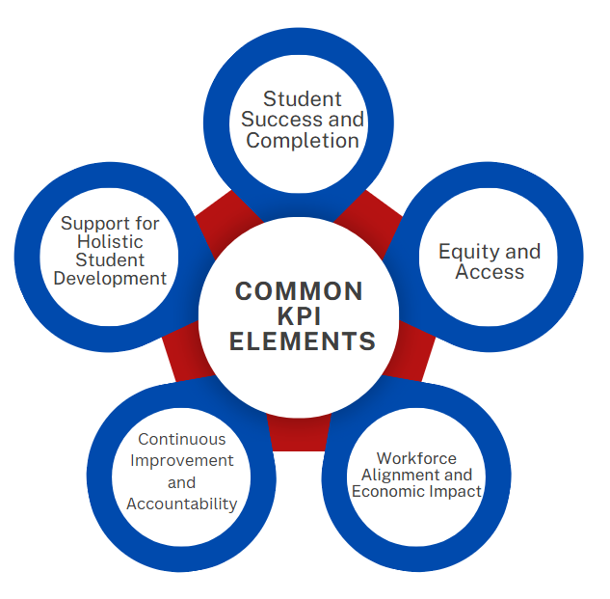
Notes:
Student Success and Completion
Each KPI set emphasizes improving rates of course completion, credential attainment, and degree or certificate completion. For example, ACCJC Institutional Set Standards and Perkins Core Indicators track completion as a measure of institutional effectiveness and CTE program quality, while Vision 2030 and Guided Pathways focus on accelerating time to completion for all students.
Equity and Access
Ensuring equitable outcomes for historically underserved students is a central theme. The Student Equity Plan specifically targets reducing achievement gaps, while Vision 2030 and Student-Centered Funding Formula incentivize success for low-income and underrepresented students. These indicators align to ensure that all students, regardless of background, have access to high-quality education and the support needed to succeed.
Workforce Alignment and Economic Impact
Programs such as the Strong Workforce Program and Perkins Core Indicators are designed to align with labor market demands, measuring employment rates and wage gains for CTE program completers. This focus on workforce readiness also appears in Student Centered Funding Formula and Vision 2030 goals, emphasizing living wage attainment as a benchmark for program effectiveness.
Continuous Improvement and Accountability
These KPIs promote data-driven decision-making and continuous improvement across institutions. ACCJC Institutional Set Standards, SRJC Indicators of Effective Outcomes, and the Guided Pathways Plan use specific metrics to track progress and assess areas for improvement, fostering accountability and transparency in educational quality.
Support for Holistic Student Development
Recognizing that student success is multifaceted, these KPIs encompass academic, career, and personal support. For example, Guided Pathways focuses on clear program pathways and integrated support services, while Student Equity Plan addresses non-academic barriers to success, such as financial and mental health resources.

Slide 9
Strategic Planning
Alignment
What We Do …
How We Do It …
Why We Do It …
How We Practice …
How We Succeed …

Slide 10
Strategic Planning
Alignment
Mission Statement
Initiative
Goal
Action Step
Measure of Success
Guided Pathways
Connection to Board Goals/ Merging Priorities
Resource allocation

Slide 11
Current
District Planning Process
Recommended
District Planning Process
Strategic Plan
Strategic Plan
Education
Education
Student Services
Student Services
Facilities Plan
Staffing Plan
Facilities Plan
Technology
Plan
Technology Plan
Staffing Plan
Strategic Enrollment Management Plan
Strategic Enrollment Management Plan
Sustainability Plan
Sustainability Plan
The Strategic Plan is Grounded on students' educational experience at SRJC elevates the Education Plan and Students Services Plan to establish a strategic plan that is collaborative and responsive to the student journey.

Slide 12
Action Steps Workgroup
Initiative | ACADEMIC QUALITY​ | STUDENT SUCCESS​ & SUPPORT ​ | RESPONSIVENESS TO OUR COMMUNITY ​ | CAMPUS CLIMATE ​ & CULTURE​
 | Support excellent teaching and maximize education learning outcomes​ ​ | Provide students with services, programs, and events in support of basic needs and educational goals to reduce student success equity gaps​ | Ensure that SRJC is supporting the diverse educational, social, and economic needs of our community​ ​ | Cultivating a campus climate and culture for individuals connected to the District that embodies our Mission, Vision, and Values ​ ​
GOAL | Ensure quality of courses and andragogy across disciplines and modalities.​ | Build a culture and ecosystem that creates a sense of belonging and purpose for all students. ​ | Offer SRJC programming that impacts all members of our community. ​ | Formalize a campus climate that is culturally aware and prioritizes efforts in support of (IDEAA). ​
Actions | 4-5 | 4-5 | 4-5 | 4-5
GOAL | Inspire and prepare students for transfer, degree or certificate completion, and lifelong learning through critical thinking and civic engagement ​ | Leverage basic needs services in support of student success while at the college and in the community​ | Provide equitable access to District opportunities in recognition of diversification in county population.​ | Promote a community culture of sustainability. ​
Actions | 4-5 | 4-5 | 4-5 | 4-5
Indicators of Effective Outcomes/ Key Performance Indicators
Charge: Recommend short-term and long-term Actions to identify how we will achieve our Initiatives and Goals.

Slide 13
Strategic Plan Guiding Principles
Innovation: The creation and implementation of new programs, resources, policies, and/or services to the college.
Growth: Expanding on current programs and expanding the utilization of resources to achieve objectives/goals of the college.
Stability: Maintaining consistent standards of quality and resource allocation. Stability is used to limit or prevent negative influences (external or internal) on goals/outcomes.
Intervention: Changing the course of a program, policy, activity, or area to improve college outcomes.

Slide 14
Action Steps: Workgroup Composition
STUDENT GOVERNMENT
MANAGEMENT
2 representatives identified by Student Government Assembly and regular SGA meeting updates.
8 management team members identified by the President’s Office. Members are from Academic Affairs, Student Services, Finance and Administration, as well as Human Resources
CLASSIFIED EMPLOYEES
Faculty
13 faculty members identified by Academic Senate and include multiple academic disciplines, contract faculty, and associate faculty.
13 classified employees identified by SEIU in collaboration with Classified Senate. Members are from Academic Affairs, Student Services, Finance and Administration, as well as Human Resources

Slide 15
Action Steps Workgroup Facilitation Team
Coordinates meeting schedules, agenda preparation, and data collection to support the development of Actions
Ensures that the process for developing Action recommendations maintains the integrity of Academic Senate (10+1) purview and employee labor relations
Co-Lead
Senior Director of Institutional Effectiveness Research and Planning
Co-Lead
Academic Senate
President
Office of Institutional Effectiveness, Research, and Planning
Director of Strategic Initiatives
Vice Presidents

Slide 16
Action Steps: Timeline (2024-2025 Academic Year)
Strategic Plan: Actions Workgroup
Strategic Plan: Actions Workgroup
Strategic Plan: Actions Workgroup
Planning and Budget Council
Constituency Review
Strategic Plan: Actions Workgroup
October
November
December
January
February – April
May - June
Actions Workgroup subgroups review Environmental Scan, Indicators of Effective Outcomes, and Guiding Principles for Planning.
Opportunity for structured input from all.
Subgroups develop initial actions
Initial actions sent to Planning and Budget Council (PBC)
PBC review of initial actions; recommendation for revision or approval for constituent review
Constituency review Support or identify areas for revision.
Workgroups review constituent feedback. Refine actions if needed and send final actions to PBC
Final Recommendations sent to:
Planning and Budget Council
Superintendent/President
Board of Trustees
Fall 2024 and Spring 2025 are dedicated to establishing the Action Steps for each Goal and gathering input from constituent groups. Adoption by the Board of Trustees is scheduled for June 2025

Slide 17
Board of Trustees Engagement
Board of Trustees Actions to Date:
Approval of BP 1200 District Mission, Vision and Values (11.8.2022)
Presentation on Initiatives (6.13.2023)
Presentation on Strategic Plan Goals and Objectives (6.13.2023)
Presentations on Indicators of Effective Outcomes (6.11.2024 and 10.8.2024)
Board of Trustees Spring 2025 Engagement Activities:
Board Study Session on Institutional Effectiveness
Opportunity to host a Community Forum
Final approval of the District Plan
Monitoring Progress via community updates and reports
Strategic Plan Website: https://strategic-planning.santarosa.edu/

Slide 18
Contact info Dr. Jeremy Smotherman Senior Director, Institutional Effectiveness, Research, and Planning jsmotherman@santarosa.edu Karolina Nazario Director, Strategic Initiatives knazario@santarosa.edu

